Slide 1
Image Classification Using Convolutional Neural Networks (CNNs)
By: Jalen Moore

Slide 2
General Overview
Convolutional Neural Networks (CNNs) are a family of models that were originally inspired by how the visual cortex of the human brain works when recognizing objects
Convolutional architectures are often described as ‘feature extraction layers;” they are able to automatically learn relevant features from raw data
Early layers (close to the input layer) extract low-level features from raw data
Later layers combine these features to construct high-level features, creating what is known as a feature hierarchy
Ex: in images, low-level features (blobs and edges) are extracted from the early layers; they are then combined to form more complex shapes (contours of objects like buildings, cats, or dogs)

Slide 3
Layers to a Convolutional Neural Network
Convolutional Layer
Subsampling (Pooling) Layer
Dropout Layer
Dense Layer

Slide 4

Convolution Layer
Signal - another term for the input vector, X
Kernel - also known as the filter, W; a vector of weights that is shifted across the signal
In order to perform this calculation, the signal must be padded with zeros; there are 3 forms of padding:
Full Padding - padding parameter p is set to p = m - 1; increases size of the output vector
Same Padding - padding parameter is computed according to the filter to maintain the output vector is the same size as the input vector
Valid Padding - padding parameter is set to p = 0
To calculate the multiplication, rotate the kernel across one or both dimensions, then shift the rotated kernel across the signal
The amount of shifting is determined by the stride parameter, s

Slide 5
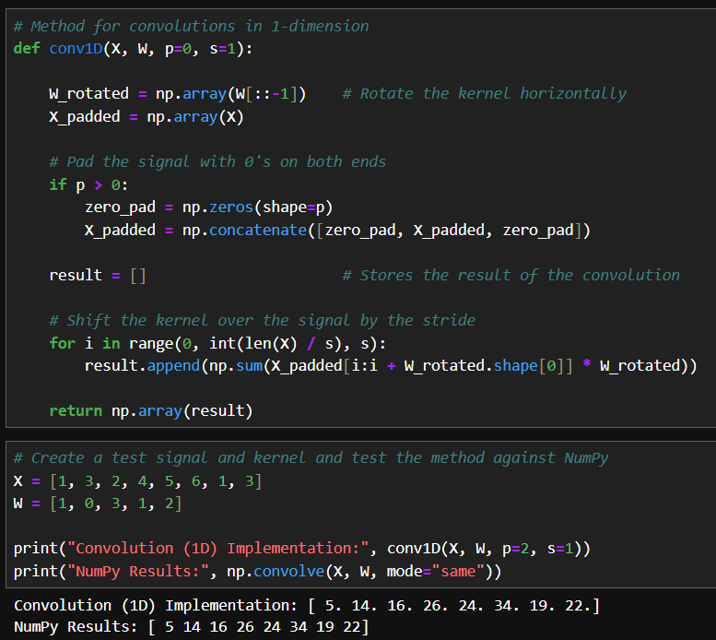
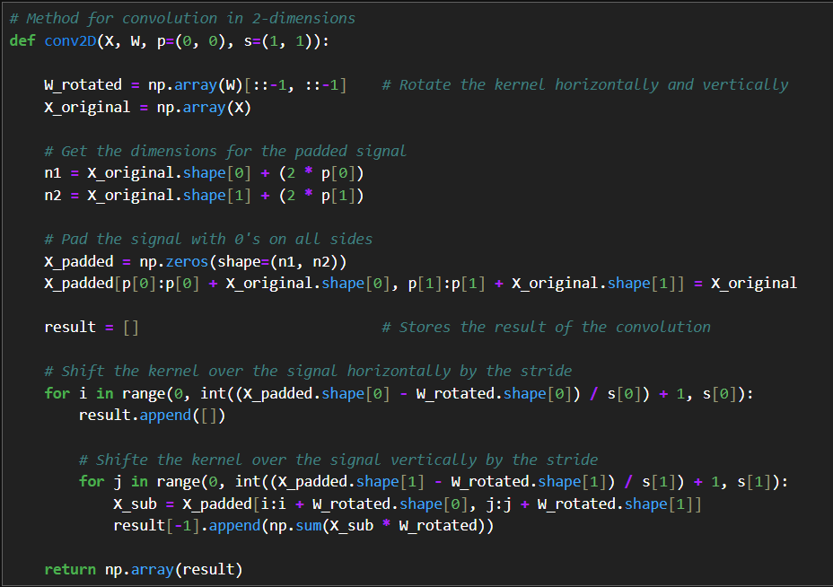

Slide 6
Subsampling (Pooling) Layer
Subsampling refers to the process of reducing the output feature size of a CNN and is typically applied through two methods of pooling:
Max-pooling: the maximum value within the pooling size is selected
Mean-pooling: the average value within the pooling size is selected
The pooling size determines the size of the neighborhood of pixels in both dimensions that either the max or mean operation is performed
There are 2 major benefits to subsampling:
Introduces local invariance, which helps generate features that are less affected by noise in the input data
Reduces the output vector, which increases efficiency

Slide 7
Dropout Layer
Dropout - a popular technique for regularizing neural networks to avoid overfitting; it is usually applied to the hidden units of higher layers
A fraction of the hidden units is randomly dropped at every iteration
The dropout probability is determined by the user, the common choice being p = 0.5
Effects of dropout:
CNN is forced to learn extra representations of the data
The model cannot rely on any set of hidden units, forcing it to learn more general patterns from the data

Slide 8
Dense Layer
The dense (or fully connected) layer is the last layer in the CNN and is used to implement a classifier on the convolutional and pooling layers
Its input must have rank 2 (batch_size X input_units)
To accomplish this, a flatten layer is applied to the output of the previous layers to reshape the vector
The units parameter of the dense layer specifies the number of output labels for the output vector

Slide 9
